Slide 1
Interspecies machine learning: Using animal training data to classify humans neurons
Luka Blagojevic, department of network and data science – 1.4.2021.
Data mining and big data analytics project

Slide 2
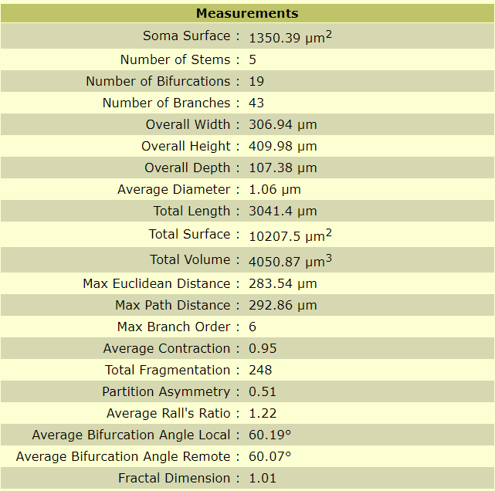
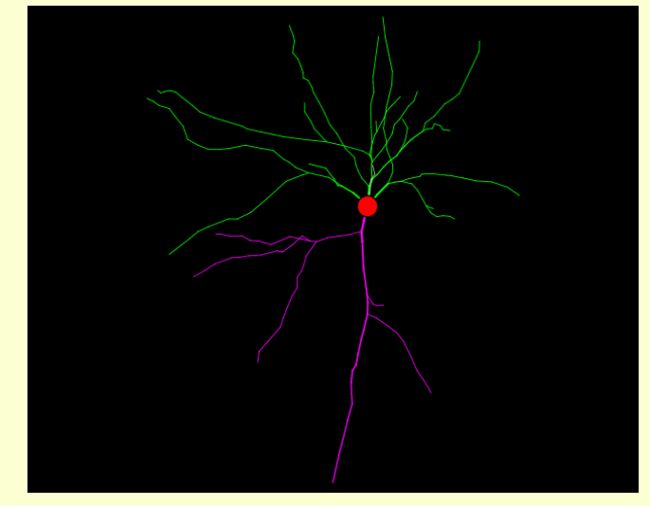
1. Introduction and dataset
Project goal: By using animal training, classify human neuron cell types
Why? A lot of easily obtainable animal data – useful since human data is harder to obtain, control for and it’s more expensive
Neuromorpho.org - animal and human neuron data
(22 features, I removed highly correlated ones – 19 used)
Two classes: 1) primary cell type (13 of them) 2) secondary cell type (31 of them)
Species | Number of data points
Human | 7150
Monkey | 2950
Rat | 7450
Mouse | 7450

Slide 3
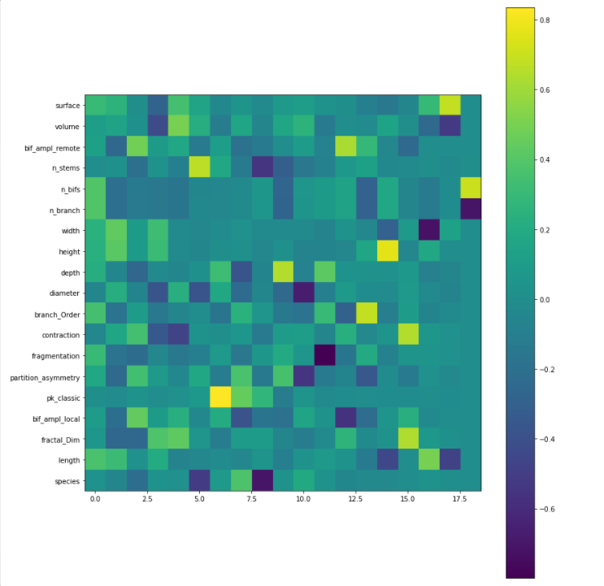
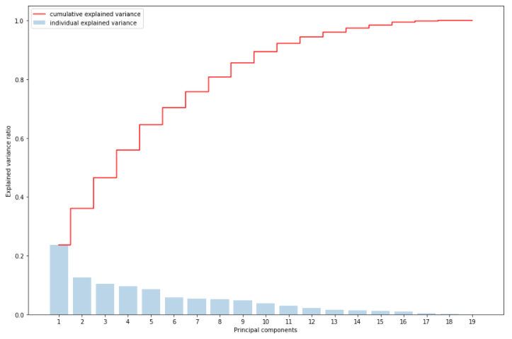
2. Principal component analysis
Coefficient visualization
Explained variance

Slide 4
3. Do classes, across species, refer to morphologically similar things?
Hypothesis: Class labels refer to the similar morphological objects across species (same name – same shape)
Intraclass similarity between species TEST – Do class labels referal to objects in of similar neuromorphological shape across species
Human data: Neuron class A
Human data: Neuron class A
Human data: Neuron class A
Mouse data: Neuron class A
Human data: Neuron class A
Human data: Neuron class A
Rejected hypothesis (same name – different shape)
1 cluster found
2 or more clusters found
Human data: Neuron class A
Mouse data: Neuron class A
Hypothesis true
Hypothesis rejected

Slide 5
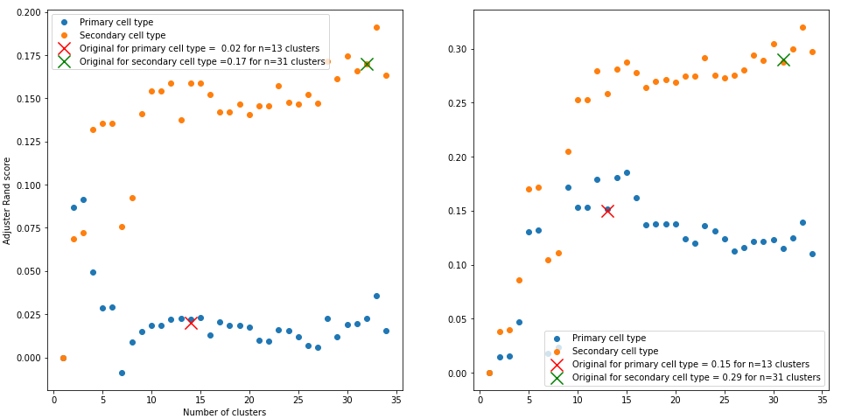
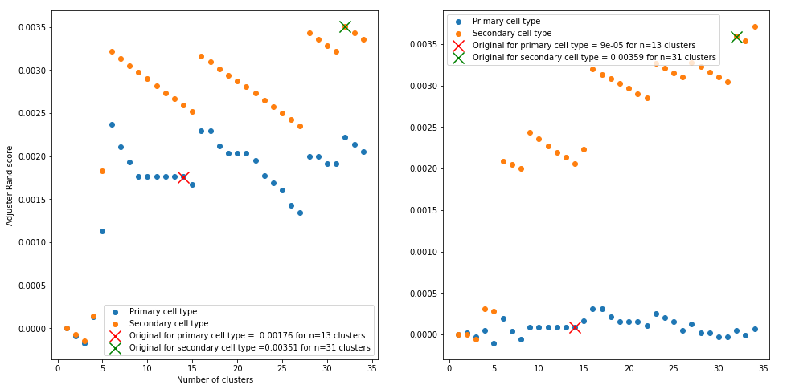
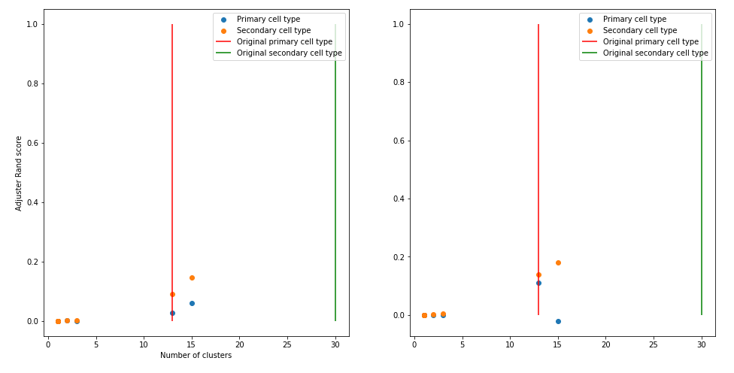
K-means
Agglomerative clustering
DB - scan
Adjusted Rand score
0 – random clustering
1 – perfect match (clustered classes and original classes)
Adjusted Mutual Information score
0 – random clustering
1 – perfect match
(clustered classes and original classes)

Slide 6
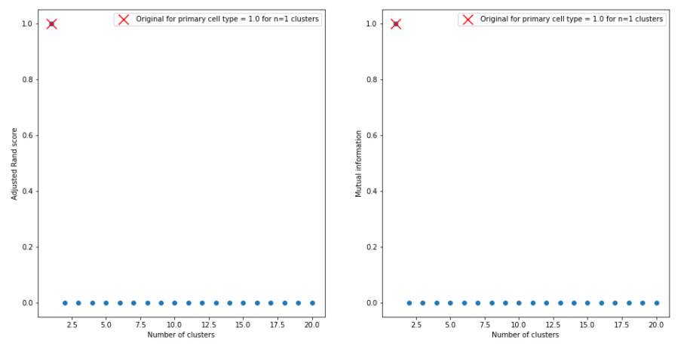
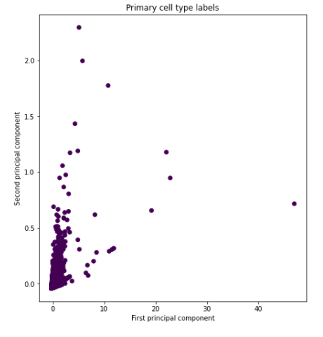
Start with 13 primary cell types that are common to humans and animals
Select next class to compute
I obtained 1 cluster for each of cell classes
Hypothesis is true
Filter the data, one cell type per run (and >20 samples)
Compute k-means for k ∈ [1,20]

Slide 7
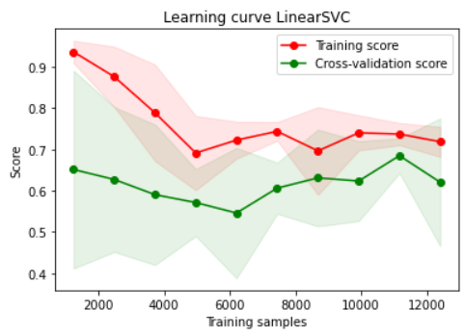
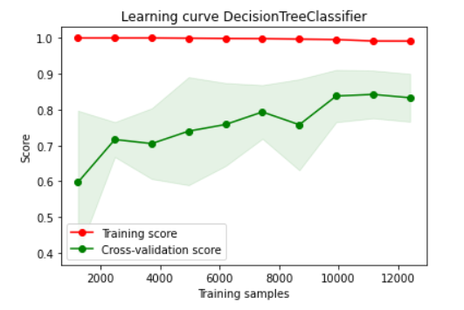
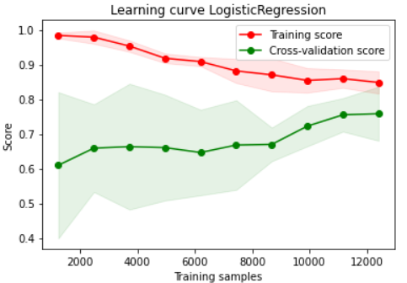
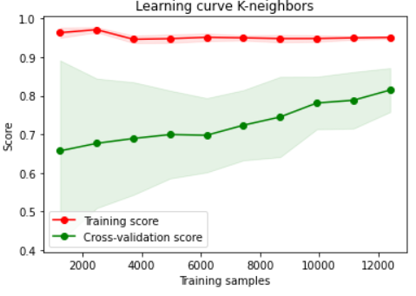
4. Hyperparameter optimization and learning curve for classifiers
With Grid search, I found optimal hyperparameters for 4 classifiers on mixed data:
Linear SVC
Logistic Regression
Decision Trees
K-neighbors Decision Trees and K-neighbors tended to overfit, so I didn’t use them for the final evaluation

Slide 8
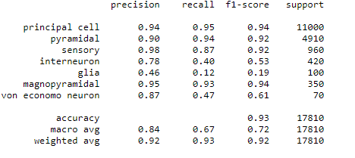
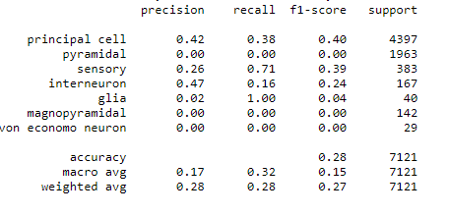
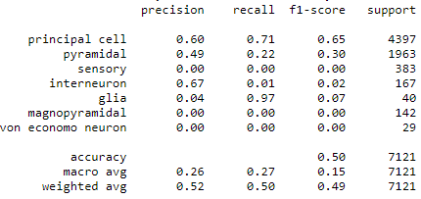
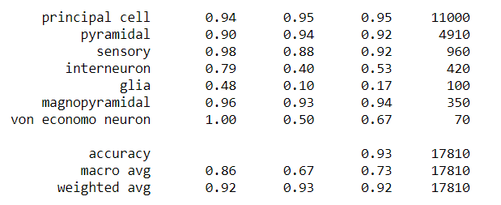
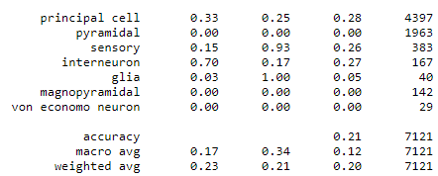
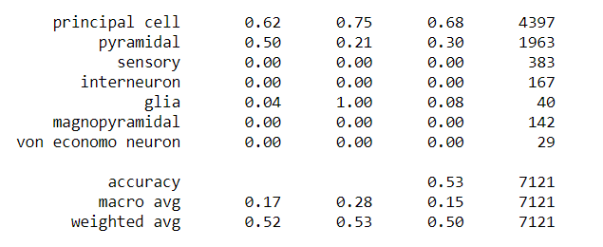
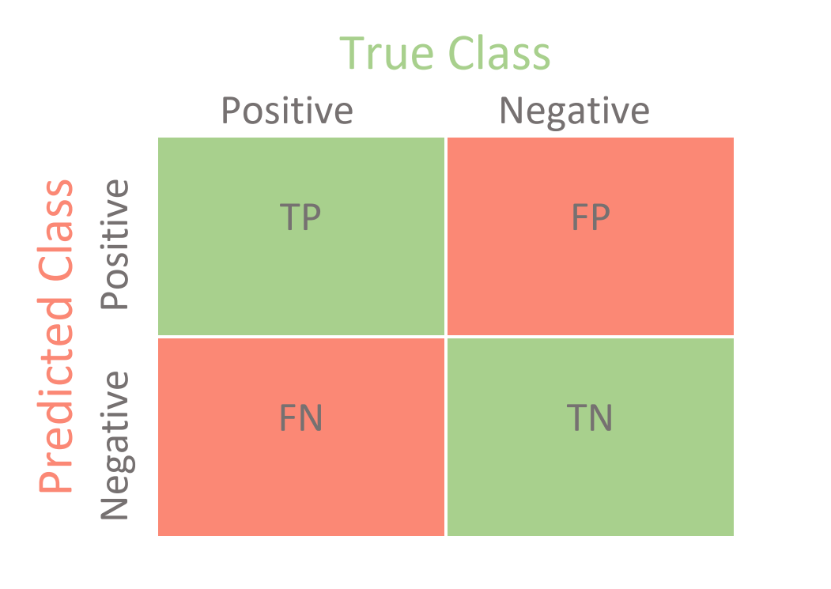




7. Results – Test data: Human neurons
It has potential, but not as good as human training data
Training data: Human
Training data: Animal
Training data: Monkey
Linear SVC
Log
Reg.
High recall – negatives are most likely (true) negatives
High precision – positives are most likely are (true) positives
Low recall – negatives are most likely not (true) negatives
Low precision – positives are most likely not (true) positives
$$Accuracy=\frac{TP+TN}{TP+TN+FP+FN}$$
$$F1=\frac{2∗Precision∗Recall}{Precision+Recall}$$
$$Recall=\frac{TP}{TP+FN}$$
$$Precision=\frac{TP}{TP+FP}$$

Slide 9
Thank you for the attention!

